Slide 1
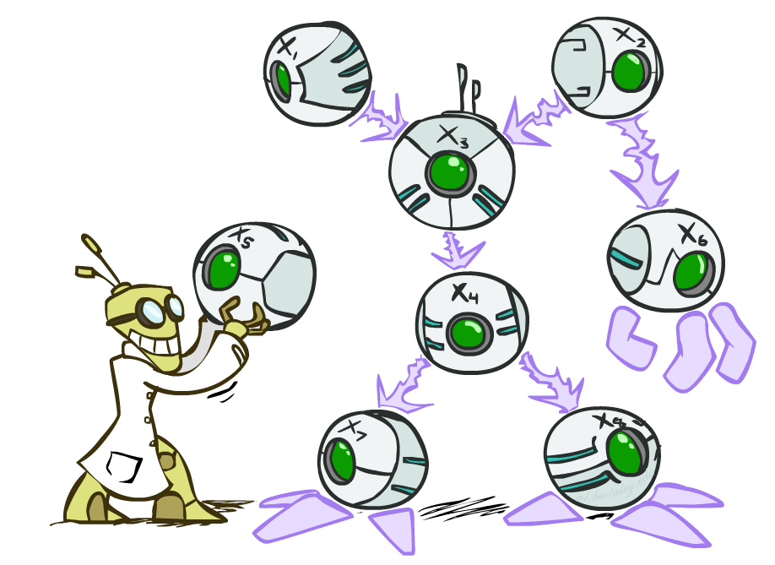
CSC2114: Artificial Intelligence
Bayes’ Nets
Instructors: Dan Klein and Pieter Abbeel --- University of California, Berkeley
[These slides were created by Dan Klein and Pieter Abbeel for CS188 Intro to AI at UC Berkeley. All CS188 materials are available at http://ai.berkeley.edu.]
Notes:
Please retain proper attribution, including the reference to ai.berkeley.edu. Thanks!

Slide 2

Probabilistic Models
Models describe how (a portion of) the world works
Models are always simplifications
May not account for every variable
May not account for all interactions between variables
“All models are wrong; but some are useful.” – George E. P. Box
What do we do with probabilistic models?
We (or our agents) need to reason about unknown variables, given evidence
Example: explanation (diagnostic reasoning)
Example: prediction (causal reasoning)
Example: value of information
Notes:
George Box: All models are wrong; some of them are useful

Slide 3

Independence

Slide 4
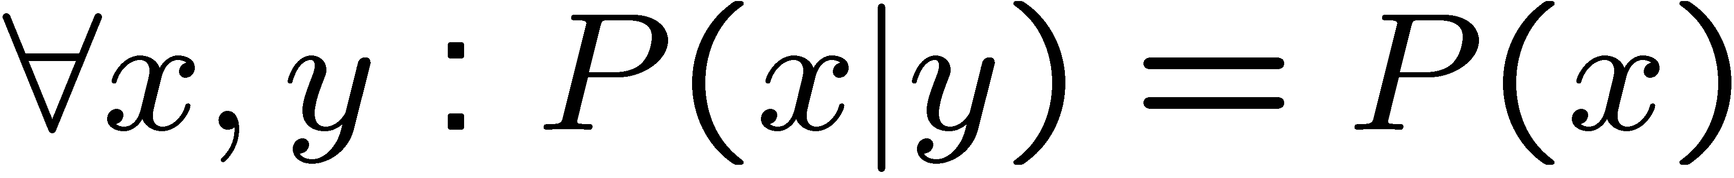
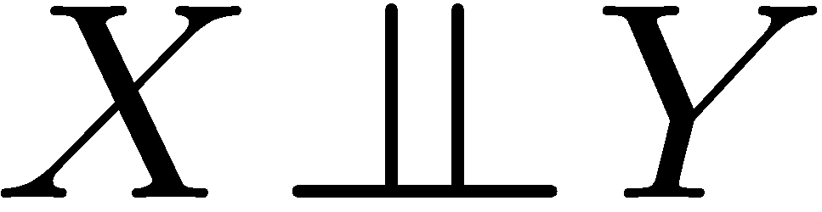
Independence
Two variables are independent if:
This says that their joint distribution factors into a product two simpler distributions
Another form:
We write:
Independence is a simplifying modeling assumption
Empirical joint distributions: at best “close” to independent
What could we assume for {Weather, Traffic, Cavity, Toothache}?

Slide 5
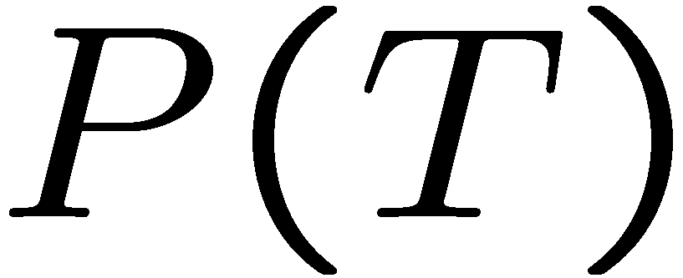
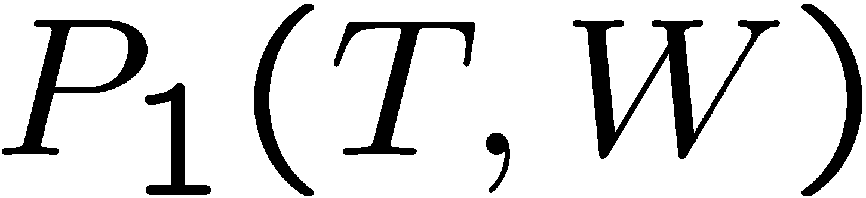
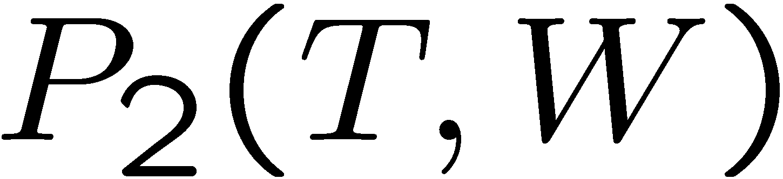
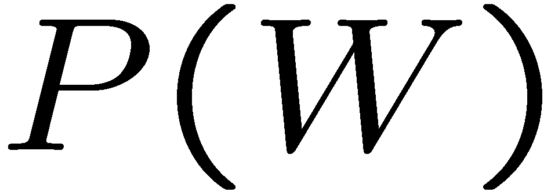
Example: Independence?
T | P
hot | 0.5
cold | 0.5
T | W | P
hot | sun | 0.4
hot | rain | 0.1
cold | sun | 0.2
cold | rain | 0.3
T | W | P
hot | sun | 0.3
hot | rain | 0.2
cold | sun | 0.3
cold | rain | 0.2
W | P
sun | 0.6
rain | 0.4

Slide 6


Example: Independence
N fair, independent coin flips:
H | 0.5
T | 0.5
H | 0.5
T | 0.5
H | 0.5
T | 0.5

Slide 7
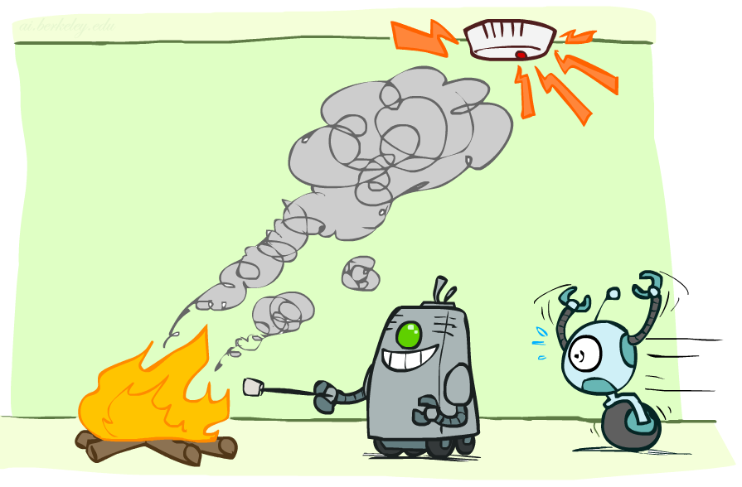
Conditional Independence

Slide 8

Conditional Independence
P(Toothache, Cavity, Catch)
If I have a cavity, the probability that the probe catches in it doesn't depend on whether I have a toothache:
P(+catch | +toothache, +cavity) = P(+catch | +cavity)
The same independence holds if I don’t have a cavity:
P(+catch | +toothache, -cavity) = P(+catch| -cavity)
Catch is conditionally independent of Toothache given Cavity:
P(Catch | Toothache, Cavity) = P(Catch | Cavity)
Equivalent statements:
P(Toothache | Catch , Cavity) = P(Toothache | Cavity)
P(Toothache, Catch | Cavity) = P(Toothache | Cavity) P(Catch | Cavity)
One can be derived from the other easily

Slide 9
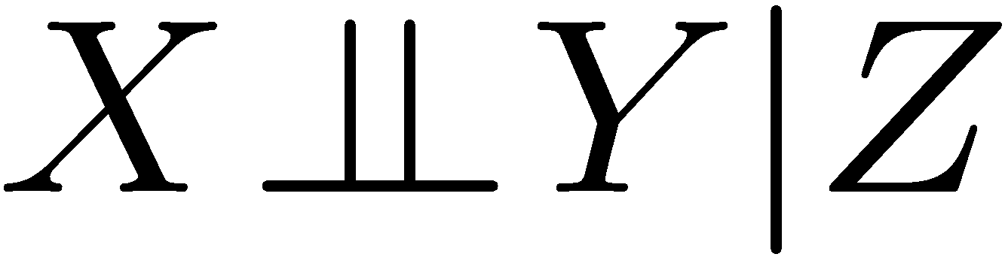
Conditional Independence
Unconditional (absolute) independence very rare (why?)
Conditional independence is our most basic and robust form of knowledge about uncertain environments.
X is conditionally independent of Y given Z
if and only if:
or, equivalently, if and only if

Slide 10
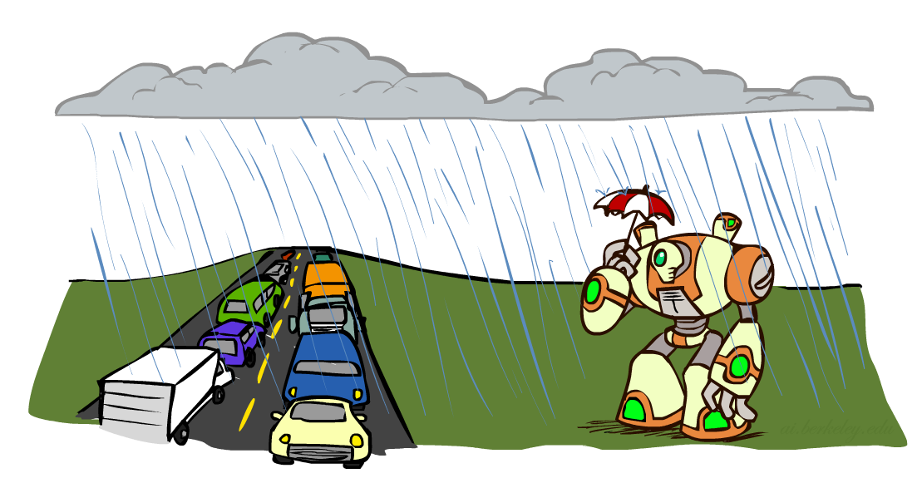
Conditional Independence
What about this domain:
Traffic
Umbrella
Raining

Slide 11

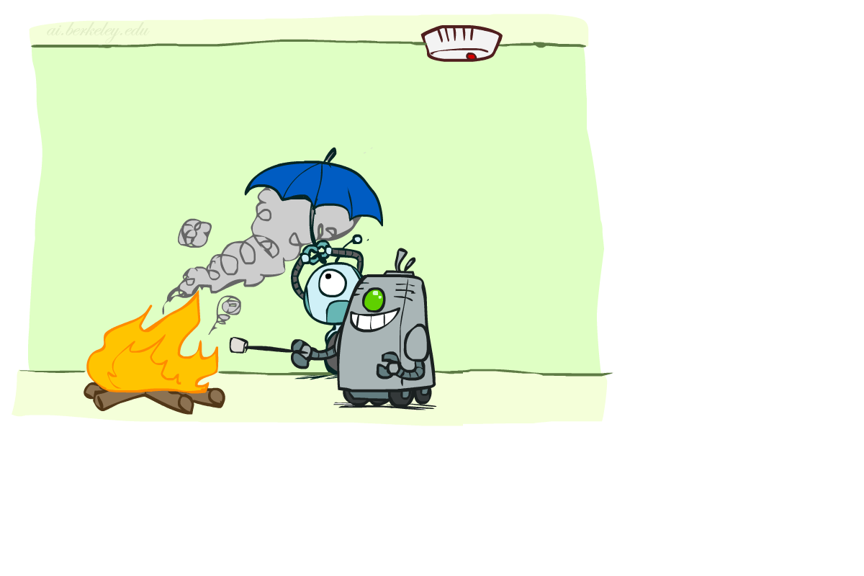
Conditional Independence
What about this domain:
Fire
Smoke
Alarm

Slide 12

Conditional Independence and the Chain Rule
Chain rule:
Trivial decomposition:
With assumption of conditional independence:
Bayes’nets / graphical models help us express conditional independence assumptions

Slide 13

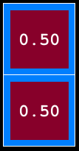
Ghostbusters Chain Rule
Each sensor depends only on where the ghost is
That means, the two sensors are conditionally independent, given the ghost position
T: Top square is red B: Bottom square is red G: Ghost is in the top
Givens:
P( +g ) = 0.5
P( -g ) = 0.5
P( +t | +g ) = 0.8 P( +t | -g ) = 0.4 P( +b | +g ) = 0.4 P( +b | -g ) = 0.8
P(T,B,G) = P(G) P(T|G) P(B|G)
T | B | G | P(T,B,G)
+t | +b | +g | 0.16
+t | +b | -g | 0.16
+t | -b | +g | 0.24
+t | -b | -g | 0.04
-t | +b | +g | 0.04
-t | +b | -g | 0.24
-t | -b | +g | 0.06
-t | -b | -g | 0.06

Slide 14
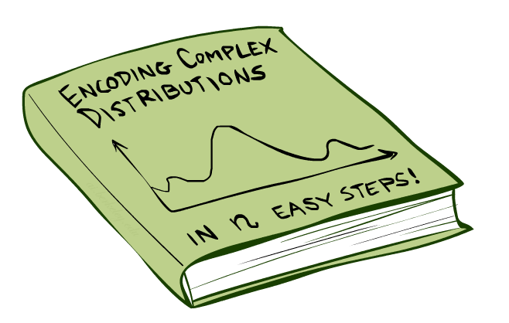
Bayes’Nets: Big Picture

Slide 15

Bayes’ Nets: Big Picture
Two problems with using full joint distribution tables as our probabilistic models:
Unless there are only a few variables, the joint is WAY too big to represent explicitly
Hard to learn (estimate) anything empirically about more than a few variables at a time
Bayes’ nets: a technique for describing complex joint distributions (models) using simple, local distributions (conditional probabilities)
More properly called graphical models
We describe how variables locally interact
Local interactions chain together to give global, indirect interactions
For about 10 min, we’ll be vague about how these interactions are specified

Slide 16
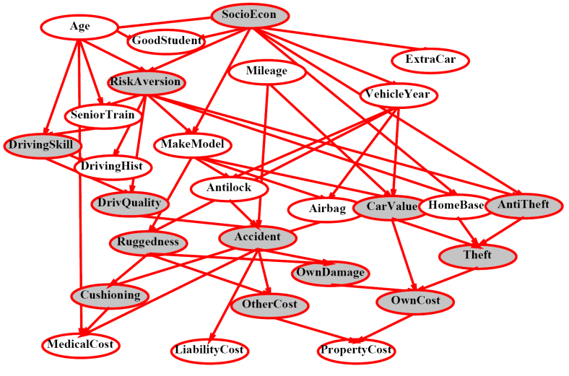
Example Bayes’ Net: Insurance

Slide 17
Example Bayes’ Net: Car

Slide 18
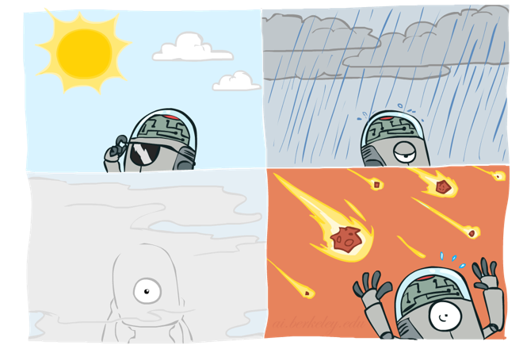
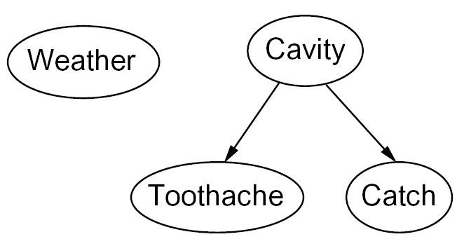
Graphical Model Notation
Nodes: variables (with domains)
Can be assigned (observed) or unassigned (unobserved)
Arcs: interactions
Similar to CSP constraints
Indicate “direct influence” between variables
Formally: encode conditional independence (more later)
For now: imagine that arrows mean direct causation (in general, they don’t!)

Slide 19
Example: Coin Flips
N independent coin flips
No interactions between variables: absolute independence
X₁
X₂
X_{n}

Slide 20
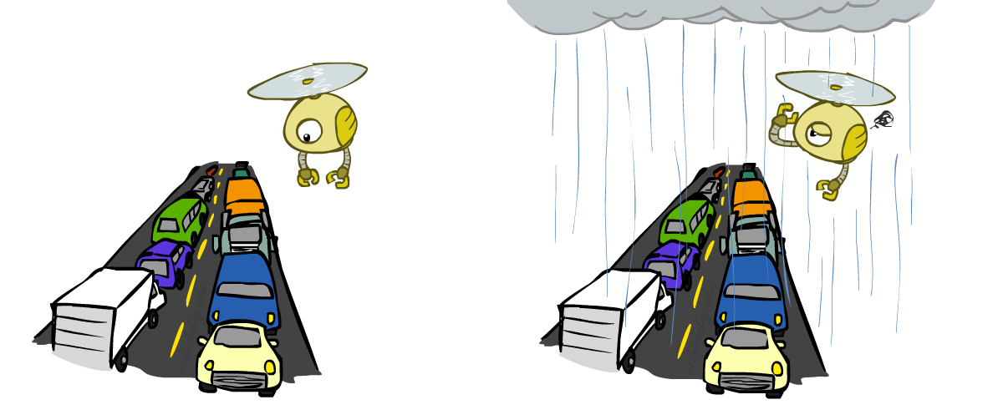
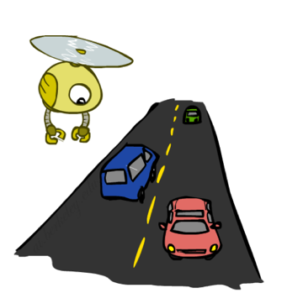
Example: Traffic
Variables:
R: It rains
T: There is traffic
Model 1: independence
Why is an agent using model 2 better?
Model 2: rain causes traffic
R
R
T
T

Slide 21
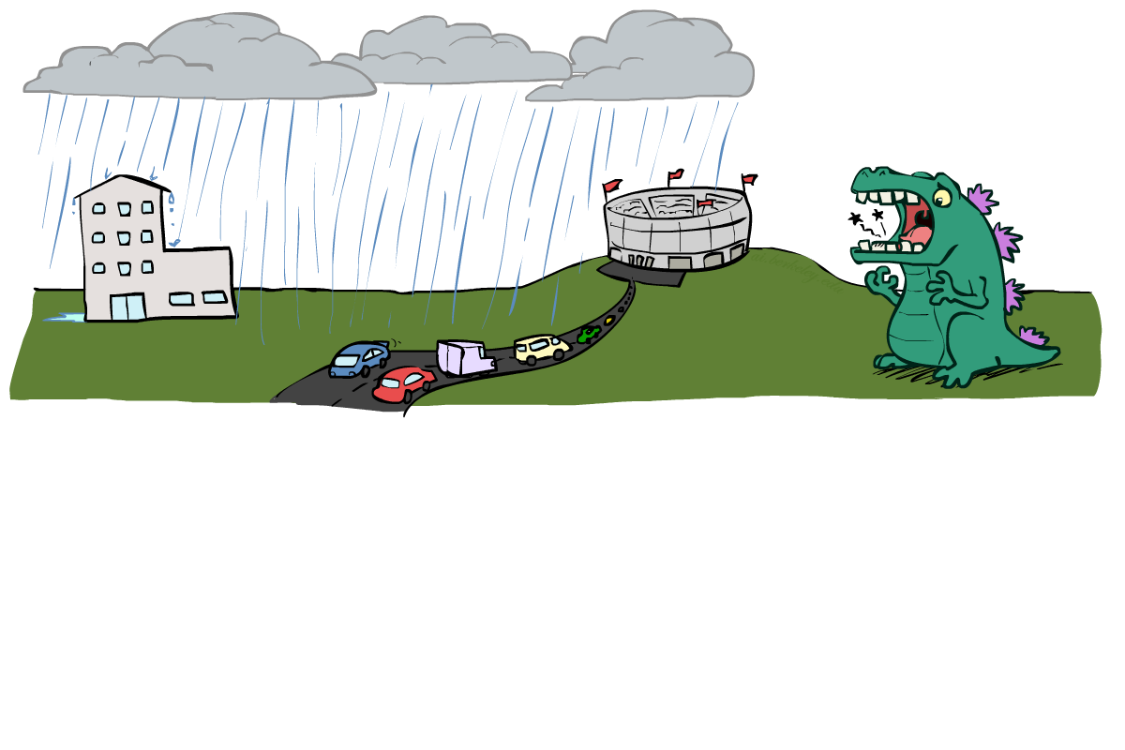
Example: Traffic II
Let’s build a causal graphical model!
Variables
T: Traffic
R: It rains
L: Low pressure
D: Roof drips
B: Ballgame
C: Cavity

Slide 22
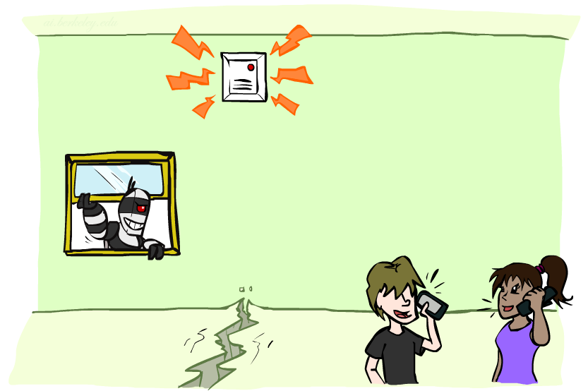
Example: Alarm Network
Variables
B: Burglary
A: Alarm goes off
M: Mary calls
J: John calls
E: Earthquake!

Slide 23
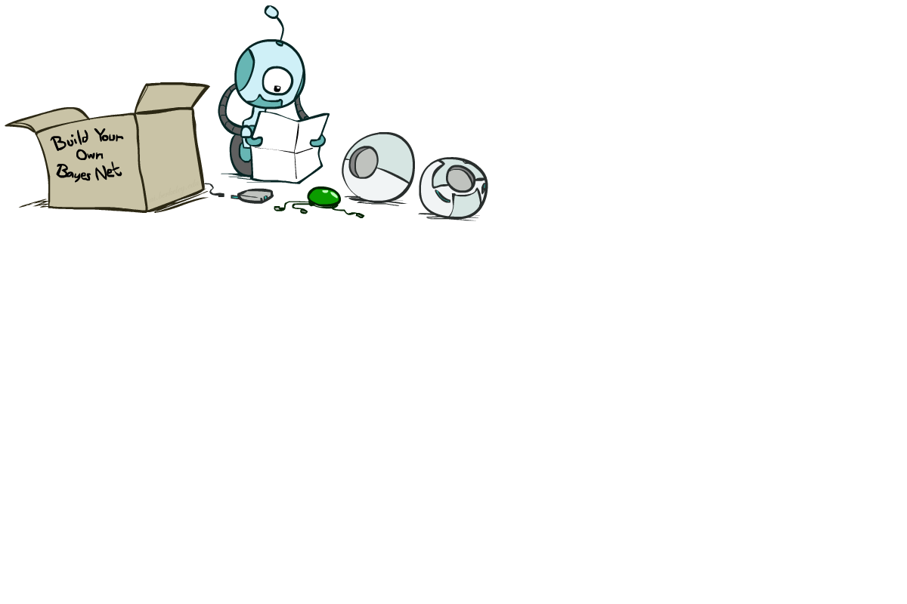
Bayes’ Net Semantics

Slide 24
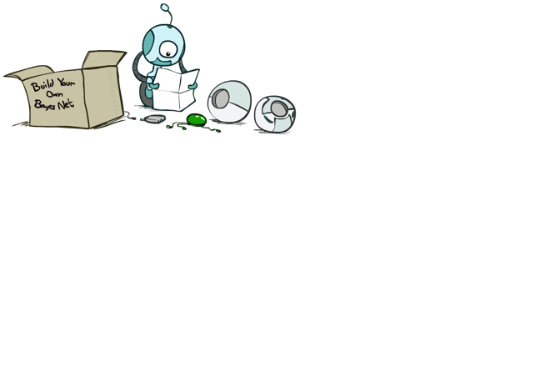
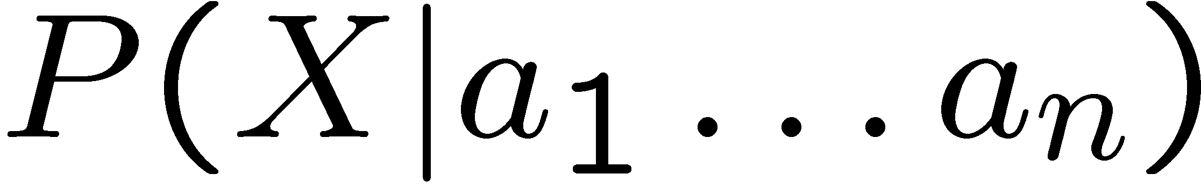
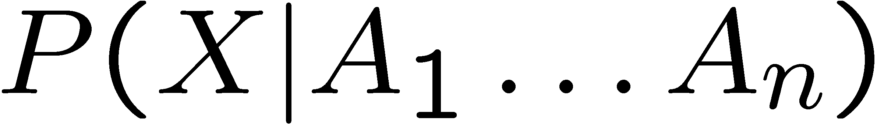
Bayes’ Net Semantics
A set of nodes, one per variable X
A directed, acyclic graph
A conditional distribution for each node
A collection of distributions over X, one for each combination of parents’ values
CPT: conditional probability table
Description of a noisy “causal” process
A₁
A_{n}
X
A Bayes net = Topology (graph) + Local Conditional Probabilities

Slide 25
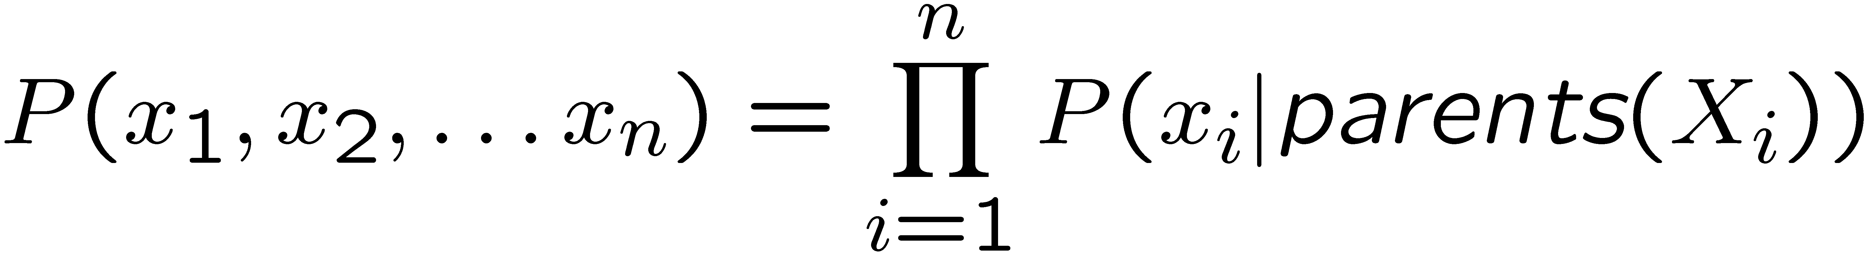

Probabilities in BNs
Bayes’ nets implicitly encode joint distributions
As a product of local conditional distributions
To see what probability a BN gives to a full assignment, multiply all the relevant conditionals together:
Example:

Slide 26
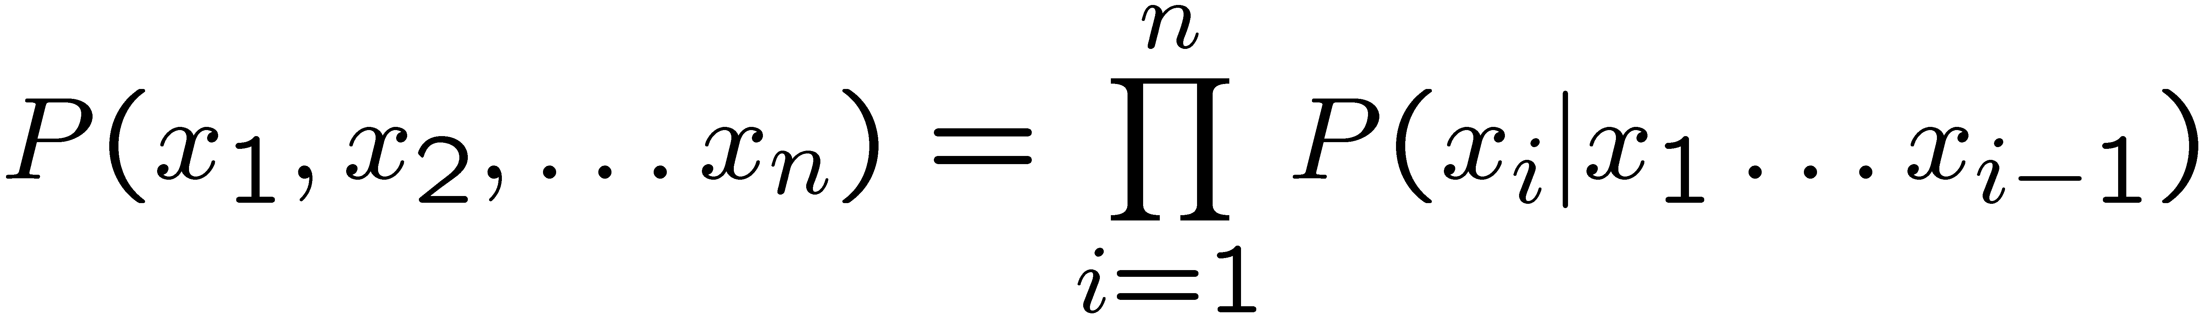
Probabilities in BNs
Why are we guaranteed that setting
results in a proper joint distribution?
Chain rule (valid for all distributions):
Assume conditional independences:
→ Consequence:
Not every BN can represent every joint distribution
The topology enforces certain conditional independencies

Slide 27
Example: Coin Flips
X₁
X₂
X_{n}
h | 0.5
t | 0.5
h | 0.5
t | 0.5
h | 0.5
t | 0.5
Only distributions whose variables are absolutely independent can be represented by a Bayes’ net with no arcs.
Notes:
demo

Slide 28

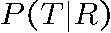
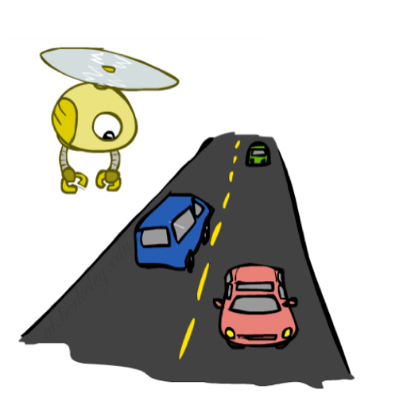
Example: Traffic
R
+r | 1/4
-r | 3/4
+r | +t | 3/4
 | -t | 1/4
T
-r | +t | 1/2
 | -t | 1/2
Notes:
demo

Slide 29
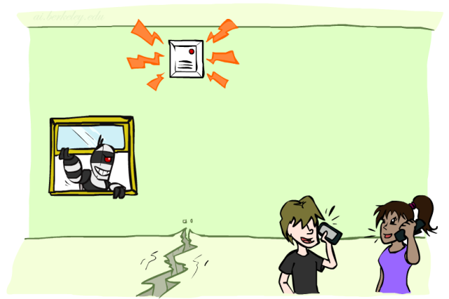
Example: Alarm Network
B | P(B)
+b | 0.001
-b | 0.999
E | P(E)
+e | 0.002
-e | 0.998
Burglary
Earthqk
Alarm
B | E | A | P(A|B,E)
+b | +e | +a | 0.95
+b | +e | -a | 0.05
+b | -e | +a | 0.94
+b | -e | -a | 0.06
-b | +e | +a | 0.29
-b | +e | -a | 0.71
-b | -e | +a | 0.001
-b | -e | -a | 0.999
John calls
Mary calls
A | J | P(J|A)
+a | +j | 0.9
+a | -j | 0.1
-a | +j | 0.05
-a | -j | 0.95
A | M | P(M|A)
+a | +m | 0.7
+a | -m | 0.3
-a | +m | 0.01
-a | -m | 0.99
Notes:
demo

Slide 30

Example: Traffic
Causal direction
R
+r | 1/4
-r | 3/4
+r | +t | 3/16
+r | -t | 1/16
-r | +t | 6/16
-r | -t | 6/16
+r | +t | 3/4
 | -t | 1/4
T
-r | +t | 1/2
 | -t | 1/2

Slide 31
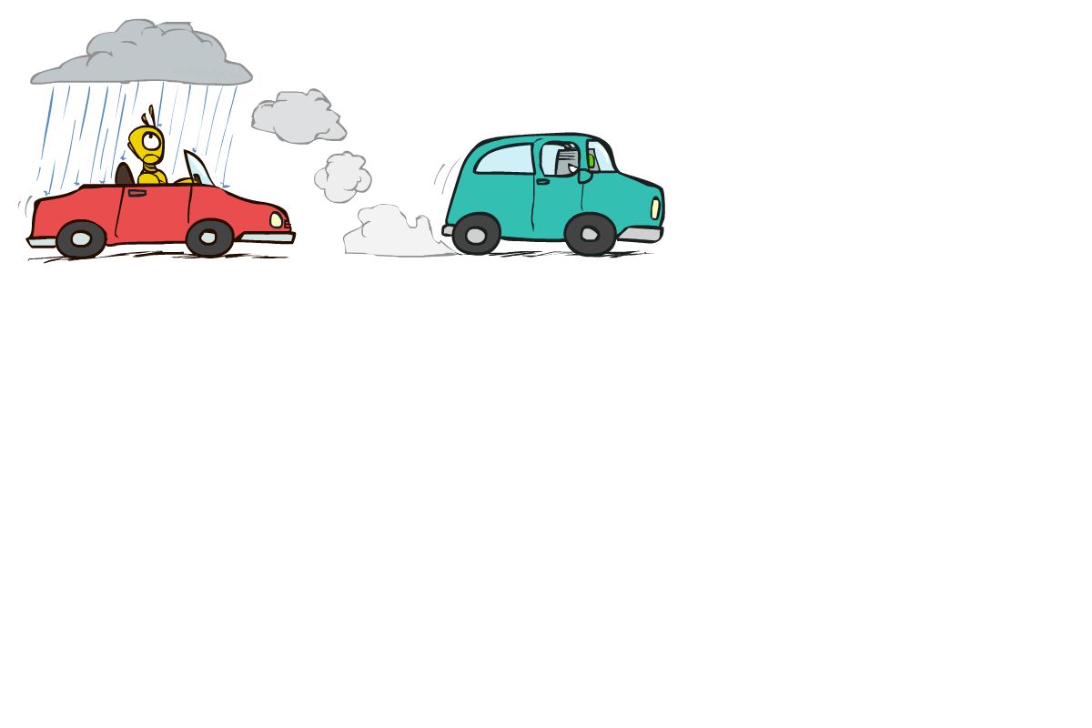
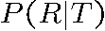
Example: Reverse Traffic
Reverse causality?
T
+t | 9/16
-t | 7/16
+r | +t | 3/16
+r | -t | 1/16
-r | +t | 6/16
-r | -t | 6/16
+t | +r | 1/3
 | -r | 2/3
R
-t | +r | 1/7
 | -r | 6/7

Slide 32
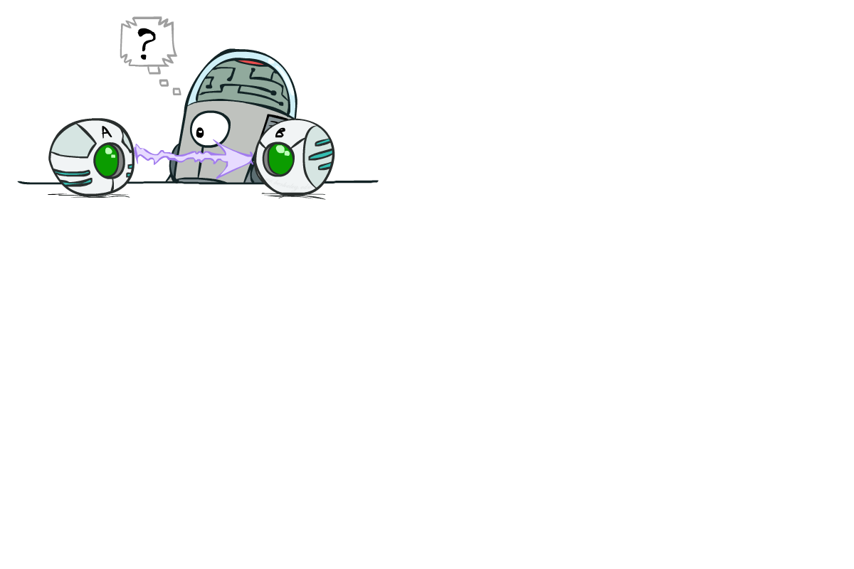
Causality?
When Bayes’ nets reflect the true causal patterns:
Often simpler (nodes have fewer parents)
Often easier to think about
Often easier to elicit from experts
BNs need not actually be causal
Sometimes no causal net exists over the domain (especially if variables are missing)
E.g. consider the variables Traffic and Drips
End up with arrows that reflect correlation, not causation
What do the arrows really mean?
Topology may happen to encode causal structure
Topology really encodes conditional independence

Slide 33
Bayes’ Nets
So far: how a Bayes’ net encodes a joint distribution
Next: how to answer queries about that distribution
Today:
First assembled BNs using an intuitive notion of conditional independence as causality
Then saw that key property is conditional independence
Main goal: answer queries about conditional independence and influence
After that: how to answer numerical queries (inference)

Slide 34
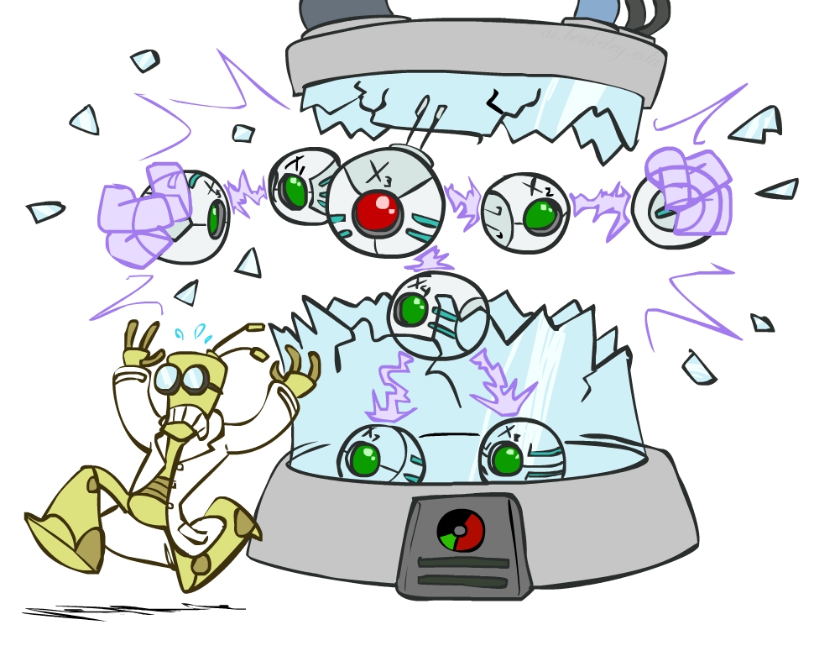
CS 188: Artificial Intelligence
Bayes’ Nets: Independence
Notes:
Please retain proper attribution, including the reference to ai.berkeley.edu. Thanks!

Slide 35

Bayes’ Nets
A Bayes’ net is an
efficient encoding
of a probabilistic
model of a domain
Questions we can ask:
Inference: given a fixed BN, what is P(X | e)?
Representation: given a BN graph, what kinds of distributions can it encode?
Modeling: what BN is most appropriate for a given domain?

Slide 36
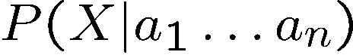
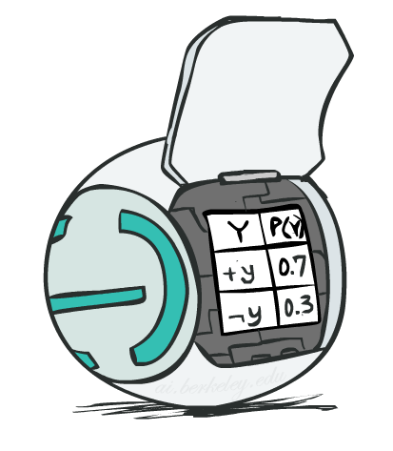
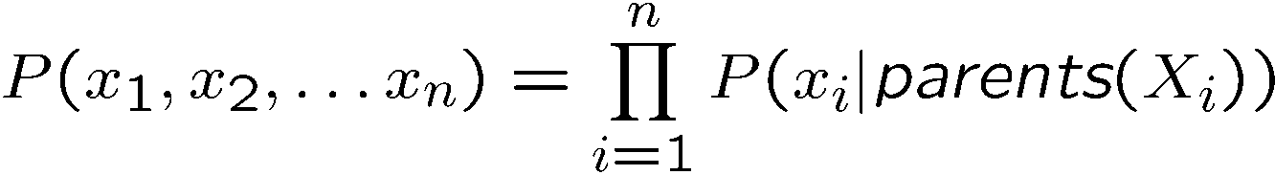
Bayes’ Net Semantics
A directed, acyclic graph, one node per random variable
A conditional probability table (CPT) for each node
A collection of distributions over X, one for each combination of parents’ values
Bayes’ nets implicitly encode joint distributions
As a product of local conditional distributions
To see what probability a BN gives to a full assignment, multiply all the relevant conditionals together:

Slide 37

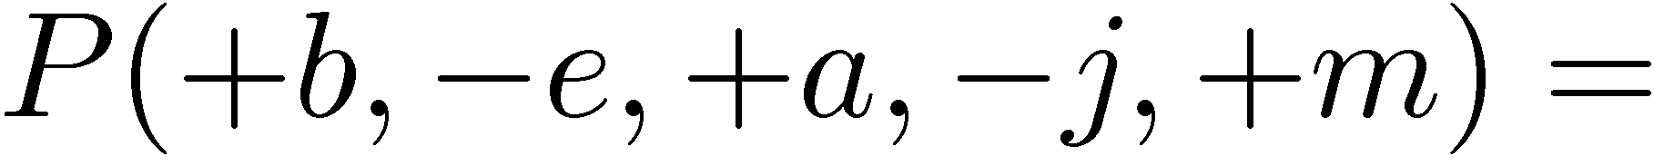
Example: Alarm Network
B | P(B)
+b | 0.001
-b | 0.999
B
E
E | P(E)
+e | 0.002
-e | 0.998
A
A | J | P(J|A)
+a | +j | 0.9
+a | -j | 0.1
-a | +j | 0.05
-a | -j | 0.95
A | M | P(M|A)
+a | +m | 0.7
+a | -m | 0.3
-a | +m | 0.01
-a | -m | 0.99
B | E | A | P(A|B,E)
+b | +e | +a | 0.95
+b | +e | -a | 0.05
+b | -e | +a | 0.94
+b | -e | -a | 0.06
-b | +e | +a | 0.29
-b | +e | -a | 0.71
-b | -e | +a | 0.001
-b | -e | -a | 0.999
J
M
Notes:
demo

Slide 38

Example: Alarm Network
B | P(B)
+b | 0.001
-b | 0.999
B
E
E | P(E)
+e | 0.002
-e | 0.998
A
A | J | P(J|A)
+a | +j | 0.9
+a | -j | 0.1
-a | +j | 0.05
-a | -j | 0.95
A | M | P(M|A)
+a | +m | 0.7
+a | -m | 0.3
-a | +m | 0.01
-a | -m | 0.99
B | E | A | P(A|B,E)
+b | +e | +a | 0.95
+b | +e | -a | 0.05
+b | -e | +a | 0.94
+b | -e | -a | 0.06
-b | +e | +a | 0.29
-b | +e | -a | 0.71
-b | -e | +a | 0.001
-b | -e | -a | 0.999
J
M
Notes:
demo

Slide 39
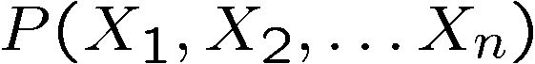
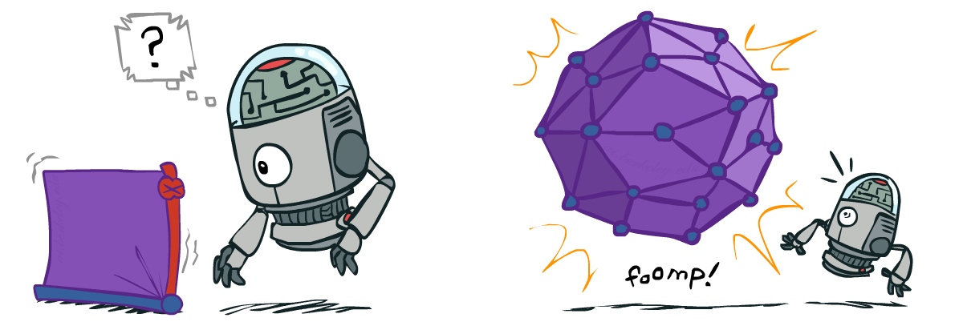
Size of a Bayes’ Net
How big is a joint distribution over N Boolean variables?
2^{N}
How big is an N-node net if nodes have up to k parents?
O(N * 2^{k+1})
Both give you the power to calculate
BNs: Huge space savings!
Also easier to elicit local CPTs
Also faster to answer queries (coming)

Slide 40

Bayes’ Nets
Representation
Conditional Independences
Probabilistic Inference
Learning Bayes’ Nets from Data

Slide 41


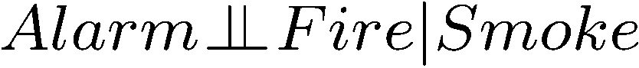
Conditional Independence
X and Y are independent if
X and Y are conditionally independent given Z
(Conditional) independence is a property of a distribution
Example:

Slide 42
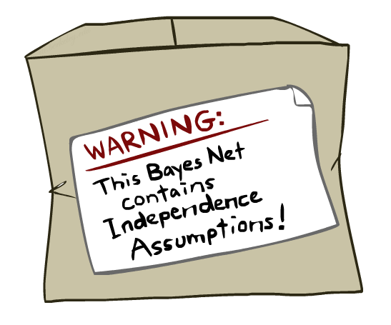
Bayes Nets: Assumptions
Assumptions we are required to make to define the Bayes net when given the graph:
Beyond above “chain rule → Bayes net” conditional independence assumptions
Often additional conditional independences
They can be read off the graph
Important for modeling: understand assumptions made when choosing a Bayes net graph
Notes:
Important for modeling: understanding which assumptions you are making!

Slide 43
Example
X
Y
Z
W
Conditional independence assumptions directly from simplifications in chain rule:
Additional implied conditional independence assumptions?

Slide 44
Independence in a BN
Important question about a BN:
Are two nodes independent given certain evidence?
If yes, can prove using algebra (tedious in general)
If no, can prove with a counter example
Example:
Question: are X and Z necessarily independent?
Answer: no. Example: low pressure causes rain, which causes traffic.
X can influence Z, Z can influence X (via Y)
Addendum: they could be independent: how?
X
Y
Z

Slide 45
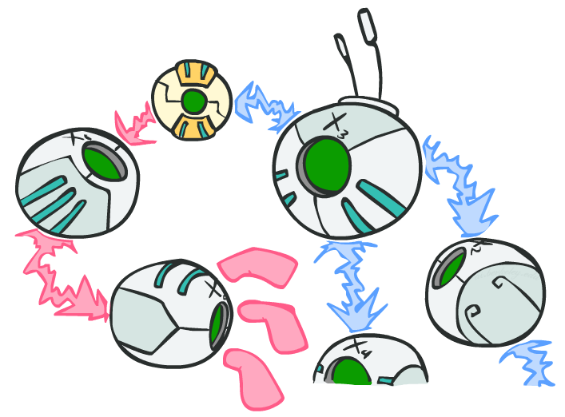
D-separation: Outline

Slide 46
D-separation: Outline
Study independence properties for triples
Analyze complex cases in terms of member triples
D-separation: a condition / algorithm for answering such queries

Slide 47
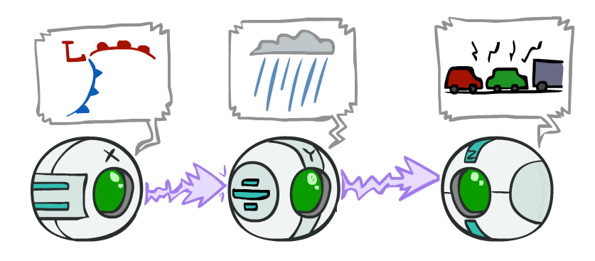
Causal Chains
This configuration is a “causal chain”
Guaranteed X independent of Z ? No!
One example set of CPTs for which X is not independent of Z is sufficient to show this independence is not guaranteed.
Example:
Low pressure causes rain causes traffic,
high pressure causes no rain causes no
traffic
In numbers:
P( +y | +x ) = 1, P( -y | - x ) = 1,
P( +z | +y ) = 1, P( -z | -y ) = 1
X: Low pressure Y: Rain Z: Traffic

Slide 48
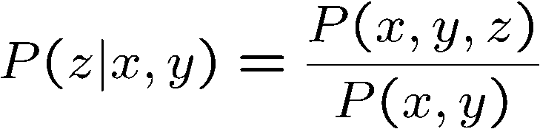
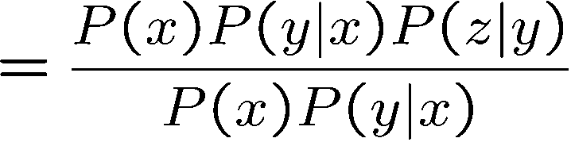
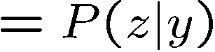
Causal Chains
This configuration is a “causal chain”
Guaranteed X independent of Z given Y?
Evidence along the chain “blocks” the influence
X: Low pressure Y: Rain Z: Traffic
Yes!

Slide 49
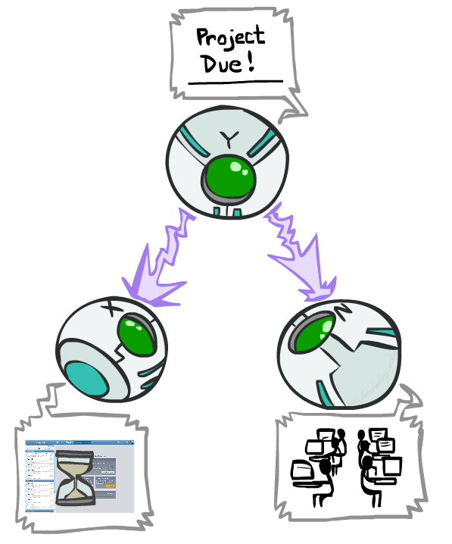
Common Cause
This configuration is a “common cause”
Guaranteed X independent of Z ? No!
One example set of CPTs for which X is not independent of Z is sufficient to show this independence is not guaranteed.
Example:
Project due causes both forums busy
and lab full
In numbers:
P( +x | +y ) = 1, P( -x | -y ) = 1,
P( +z | +y ) = 1, P( -z | -y ) = 1
Y: Project due
X: Forums busy
Z: Lab full

Slide 50
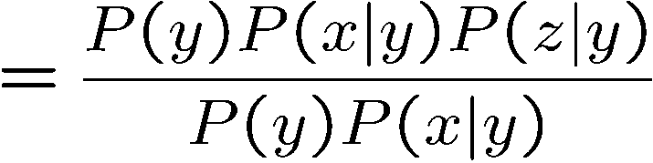
Common Cause
This configuration is a “common cause”
Guaranteed X and Z independent given Y?
Observing the cause blocks influence between effects.
Y: Project due
X: Forums busy
Z: Lab full
Yes!

Slide 51
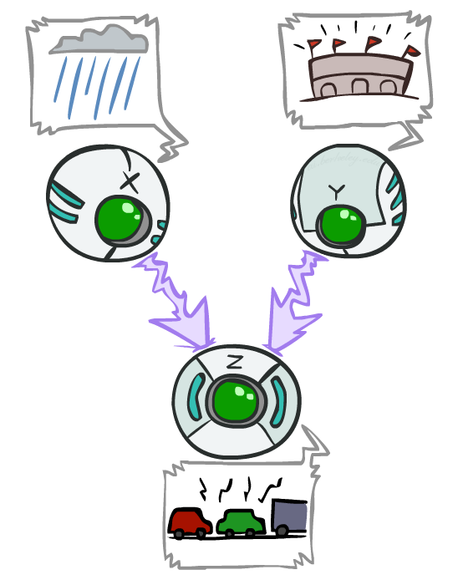
Common Effect
Last configuration: two causes of one effect (v-structures)
Are X and Y independent?
Yes: the ballgame and the rain cause traffic, but they are not correlated
Still need to prove they must be (try it!)
Are X and Y independent given Z?
No: seeing traffic puts the rain and the ballgame in competition as explanation.
This is backwards from the other cases
Observing an effect activates influence between possible causes.
X: Raining
Y: Ballgame
Z: Traffic

Slide 52
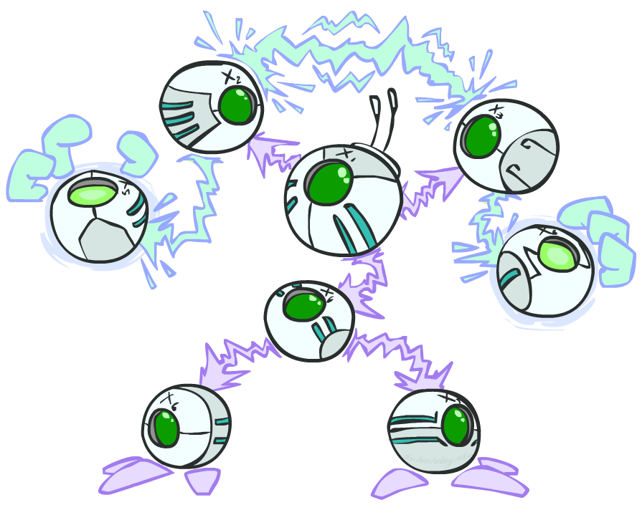
The General Case
General question: in a given BN, are two variables independent (given evidence)?
Solution: analyze the graph
Any complex example can be broken
into repetitions of the three canonical cases

Slide 53


Reachability
L
Recipe: shade evidence nodes, look for paths in the resulting graph
Attempt 1: if two nodes are connected by an undirected path not blocked by a shaded node, they are conditionally independent
Almost works, but not quite
Where does it break?
Answer: the v-structure at T doesn’t count as a link in a path unless “active”
R
B
D
T

Slide 54
Active / Inactive Paths
Question: Are X and Y conditionally independent given evidence variables {Z}?
Yes, if X and Y “d-separated” by Z
Consider all (undirected) paths from X to Y
No active paths = independence!
A path is active if each triple is active:
Causal chain A → B → C where B is unobserved (either direction)
Common cause A ← B → C where B is unobserved
Common effect (aka v-structure)
A → B ← C where B or one of its descendents is observed
All it takes to block a path is a single inactive segment
Active Triples
Inactive Triples

Slide 55



D-Separation
?
Query:
Check all (undirected!) paths between and
If one or more active, then independence not guaranteed
Otherwise (i.e. if all paths are inactive),
then independence is guaranteed

Slide 56



Example
Yes
R
B
T
T’
Notes:
T’: traffic report

Slide 57





Example
L
Yes
R
B
Yes
D
T
Yes
T’

Slide 58



Example
Variables:
R: Raining
T: Traffic
D: Roof drips
S: I’m sad
Questions:
R
T
D
S
Yes

Slide 59

Structure Implications
Given a Bayes net structure, can run d-separation algorithm to build a complete list of conditional independences that are necessarily true of the form
This list determines the set of probability distributions that can be represented

Slide 60

Computing All Independences
Y
X
Z
Y
X
Z
X
Z
Y
Y
X
Z

Slide 61
Topology Limits Distributions
Given some graph topology G, only certain joint distributions can be encoded
The graph structure guarantees certain (conditional) independences
(There might be more independence)
Adding arcs increases the set of distributions, but has several costs
Full conditioning can encode any distribution
Y
Y
X
Z
X
Z
Y
X
Z
Y
X
Z
Y
Y
Y
X
Z
X
Z
X
Z
Y
Y
Y
X
Z
X
Z
X
Z

Slide 62
Bayes Nets Representation Summary
Bayes nets compactly encode joint distributions
Guaranteed independencies of distributions can be deduced from BN graph structure
D-separation gives precise conditional independence guarantees from graph alone
A Bayes’ net’s joint distribution may have further (conditional) independence that is not detectable until you inspect its specific distribution

Slide 63
Bayes’ Nets
Representation
Conditional Independences
Probabilistic Inference
Enumeration (exact, exponential complexity)
Variable elimination (exact, worst-case
exponential complexity, often better)
Probabilistic inference is NP-complete
Sampling (approximate)
Learning Bayes’ Nets from Data

Slide 64
Bayes’ Net Representation
A directed, acyclic graph, one node per random variable
A conditional probability table (CPT) for each node
A collection of distributions over X, one for each combination of parents’ values
Bayes’ nets implicitly encode joint distributions
As a product of local conditional distributions
To see what probability a BN gives to a full assignment, multiply all the relevant conditionals together:

Slide 65

Example: Alarm Network
B | P(B)
+b | 0.001
-b | 0.999
E | P(E)
+e | 0.002
-e | 0.998
Burglary
Earthqk
Alarm
B | E | A | P(A|B,E)
+b | +e | +a | 0.95
+b | +e | -a | 0.05
+b | -e | +a | 0.94
+b | -e | -a | 0.06
-b | +e | +a | 0.29
-b | +e | -a | 0.71
-b | -e | +a | 0.001
-b | -e | -a | 0.999
John calls
Mary calls
A | J | P(J|A)
+a | +j | 0.9
+a | -j | 0.1
-a | +j | 0.05
-a | -j | 0.95
A | M | P(M|A)
+a | +m | 0.7
+a | -m | 0.3
-a | +m | 0.01
-a | -m | 0.99
[Demo: BN Applet]
Notes:
Demo:
Draw network
Specify the CPTs
Then query, e.g., Mary Calls --- not something we specified, inference computed this for us
P(B) = ?
P(B | +e) = ?
Independence
P(B) = ?
P(B | +m) = ?
Show explaining away

Slide 66
Example: Alarm Network
B | P(B)
+b | 0.001
-b | 0.999
B
E
E | P(E)
+e | 0.002
-e | 0.998
A
A | J | P(J|A)
+a | +j | 0.9
+a | -j | 0.1
-a | +j | 0.05
-a | -j | 0.95
A | M | P(M|A)
+a | +m | 0.7
+a | -m | 0.3
-a | +m | 0.01
-a | -m | 0.99
B | E | A | P(A|B,E)
+b | +e | +a | 0.95
+b | +e | -a | 0.05
+b | -e | +a | 0.94
+b | -e | -a | 0.06
-b | +e | +a | 0.29
-b | +e | -a | 0.71
-b | -e | +a | 0.001
-b | -e | -a | 0.999
J
M
Notes:
demo

Slide 67

Example: Alarm Network
B | P(B)
+b | 0.001
-b | 0.999
B
E
E | P(E)
+e | 0.002
-e | 0.998
A
A | J | P(J|A)
+a | +j | 0.9
+a | -j | 0.1
-a | +j | 0.05
-a | -j | 0.95
A | M | P(M|A)
+a | +m | 0.7
+a | -m | 0.3
-a | +m | 0.01
-a | -m | 0.99
B | E | A | P(A|B,E)
+b | +e | +a | 0.95
+b | +e | -a | 0.05
+b | -e | +a | 0.94
+b | -e | -a | 0.06
-b | +e | +a | 0.29
-b | +e | -a | 0.71
-b | -e | +a | 0.001
-b | -e | -a | 0.999
J
M
Notes:
demo

Slide 68

Bayes’ Nets
Representation
Conditional Independences
Probabilistic Inference
Enumeration (exact, exponential complexity)
Variable elimination (exact, worst-case exponential complexity, often better)
Inference is NP-complete
Sampling (approximate)
Learning Bayes’ Nets from Data

Slide 69

Inference
Inference: calculating some useful quantity from a joint probability distribution
Examples:
Posterior probability
Most likely explanation:

Slide 70











Inference by Enumeration
* Works fine with multiple query variables, too
General case:
Evidence variables:
Query* variable:
Hidden variables:
We want:
All variables
Step 1: Select the entries consistent with the evidence
Step 2: Sum out H to get joint of Query and evidence
Step 3: Normalize

Slide 71
Inference by Enumeration in Bayes’ Net
Given unlimited time, inference in BNs is easy
Reminder of inference by enumeration by example:
B
E
A
J
M

Slide 72

Inference by Enumeration?

Slide 73


Inference by Enumeration vs. Variable Elimination
Why is inference by enumeration so slow?
You join up the whole joint distribution before you sum out the hidden variables
Idea: interleave joining and marginalizing!
Called “Variable Elimination”
Still NP-hard, but usually much faster than inference by enumeration
First we’ll need some new notation: factors

Slide 74

Factor Zoo

Slide 75



Factor Zoo I
Joint distribution: P(X,Y)
Entries P(x,y) for all x, y
Sums to 1
Selected joint: P(x,Y)
A slice of the joint distribution
Entries P(x,y) for fixed x, all y
Sums to P(x)
Number of capitals = dimensionality of the table
T | W | P
hot | sun | 0.4
hot | rain | 0.1
cold | sun | 0.2
cold | rain | 0.3
T | W | P
cold | sun | 0.2
cold | rain | 0.3

Slide 76






Factor Zoo II
Single conditional: P(Y | x)
Entries P(y | x) for fixed x, all y
Sums to 1
Family of conditionals:
P(X |Y)
Multiple conditionals
Entries P(x | y) for all x, y
Sums to |Y|
T | W | P
cold | sun | 0.4
cold | rain | 0.6
T | W | P
hot | sun | 0.8
hot | rain | 0.2
cold | sun | 0.4
cold | rain | 0.6

Slide 77




Factor Zoo III
Specified family: P( y | X )
Entries P(y | x) for fixed y,
but for all x
Sums to … who knows!
T | W | P
hot | rain | 0.2
cold | rain | 0.6

Slide 78




Factor Zoo Summary
In general, when we write P(Y₁ … Y_{N} | X₁ … X_{M})
It is a “factor,” a multi-dimensional array
Its values are P(y₁ … y_{N} | x₁ … x_{M})
Any assigned (=lower-case) X or Y is a dimension missing (selected) from the array

Slide 79



Example: Traffic Domain
Random Variables
R: Raining
T: Traffic
L: Late for class!
+r | 0.1
-r | 0.9
R
T
+r | +t | 0.8
+r | -t | 0.2
-r | +t | 0.1
-r | -t | 0.9
L
+t | +l | 0.3
+t | -l | 0.7
-t | +l | 0.1
-t | -l | 0.9

Slide 80

Variable Elimination (VE)

Slide 81







Inference by Enumeration: Procedural Outline
Track objects called factors
Initial factors are local CPTs (one per node)
Any known values are selected
E.g. if we know , the initial factors are
Procedure: Join all factors, then eliminate all hidden variables
+r | 0.1
-r | 0.9
+r | +t | 0.8
+r | -t | 0.2
-r | +t | 0.1
-r | -t | 0.9
+t | +l | 0.3
+t | -l | 0.7
-t | +l | 0.1
-t | -l | 0.9
+r | 0.1
-r | 0.9
+r | +t | 0.8
+r | -t | 0.2
-r | +t | 0.1
-r | -t | 0.9
+t | +l | 0.3
-t | +l | 0.1

Slide 82





Operation 1: Join Factors
First basic operation: joining factors
Combining factors:
Just like a database join
Get all factors over the joining variable
Build a new factor over the union of the variables involved
Example: Join on R
Computation for each entry: pointwise products
R
+r | 0.1
-r | 0.9
+r | +t | 0.8
+r | -t | 0.2
-r | +t | 0.1
-r | -t | 0.9
+r | +t | 0.08
+r | -t | 0.02
-r | +t | 0.09
-r | -t | 0.81
R,T
T

Slide 83

Example: Multiple Joins

Slide 84



Example: Multiple Joins
+r | 0.1
-r | 0.9
R
Join R
Join T
+r | +t | 0.08
+r | -t | 0.02
-r | +t | 0.09
-r | -t | 0.81
R, T, L
T
+r | +t | 0.8
+r | -t | 0.2
-r | +t | 0.1
-r | -t | 0.9
R, T
+r | +t | +l | 0.024
+r | +t | -l | 0.056
+r | -t | +l | 0.002
+r | -t | -l | 0.018
-r | +t | +l | 0.027
-r | +t | -l | 0.063
-r | -t | +l | 0.081
-r | -t | -l | 0.729
L
L
+t | +l | 0.3
+t | -l | 0.7
-t | +l | 0.1
-t | -l | 0.9
+t | +l | 0.3
+t | -l | 0.7
-t | +l | 0.1
-t | -l | 0.9

Slide 85



Operation 2: Eliminate
Second basic operation: marginalization
Take a factor and sum out a variable
Shrinks a factor to a smaller one
A projection operation
Example:
+r | +t | 0.08
+r | -t | 0.02
-r | +t | 0.09
-r | -t | 0.81
+t | 0.17
-t | 0.83

Slide 86



Multiple Elimination
R, T, L
T, L
L
+r | +t | +l | 0.024
+r | +t | -l | 0.056
+r | -t | +l | 0.002
+r | -t | -l | 0.018
-r | +t | +l | 0.027
-r | +t | -l | 0.063
-r | -t | +l | 0.081
-r | -t | -l | 0.729
Sum
out R
Sum
out T
+t | +l | 0.051
+t | -l | 0.119
-t | +l | 0.083
-t | -l | 0.747
+l | 0.134
-l | 0.886

Slide 87

Thus Far: Multiple Join, Multiple Eliminate (= Inference by Enumeration)

Slide 88

Marginalizing Early (= Variable Elimination)

Slide 89
Traffic Domain
R
Inference by Enumeration
Variable Elimination
T
L
Join on r
Join on r
Join on t
Eliminate r
Eliminate r
Join on t
Eliminate t
Eliminate t

Slide 90


Marginalizing Early! (aka VE)
Join R
Sum out R
Join T
Sum out T
+r | +t | 0.08
+r | -t | 0.02
-r | +t | 0.09
-r | -t | 0.81
+r | 0.1
-r | 0.9
+t | 0.17
-t | 0.83
R
T
T, L
R, T
L
+r | +t | 0.8
+r | -t | 0.2
-r | +t | 0.1
-r | -t | 0.9
T
L
L
+t | +l | 0.051
+t | -l | 0.119
-t | +l | 0.083
-t | -l | 0.747
+l | 0.134
-l | 0.866
L
+t | +l | 0.3
+t | -l | 0.7
-t | +l | 0.1
-t | -l | 0.9
+t | +l | 0.3
+t | -l | 0.7
-t | +l | 0.1
-t | -l | 0.9
+t | +l | 0.3
+t | -l | 0.7
-t | +l | 0.1
-t | -l | 0.9

Slide 91




Evidence
If evidence, start with factors that select that evidence
No evidence uses these initial factors:
Computing , the initial factors become:
We eliminate all vars other than query + evidence
+r | 0.1
-r | 0.9
+r | +t | 0.8
+r | -t | 0.2
-r | +t | 0.1
-r | -t | 0.9
+t | +l | 0.3
+t | -l | 0.7
-t | +l | 0.1
-t | -l | 0.9
+r | 0.1
+r | +t | 0.8
+r | -t | 0.2
+t | +l | 0.3
+t | -l | 0.7
-t | +l | 0.1
-t | -l | 0.9

Slide 92

Evidence II
Result will be a selected joint of query and evidence
E.g. for P(L | +r), we would end up with:
To get our answer, just normalize this!
That ’s it!
Normalize
+r | +l | 0.026
+r | -l | 0.074
+l | 0.26
-l | 0.74

Slide 93




General Variable Elimination
Query:
Start with initial factors:
Local CPTs (but instantiated by evidence)
While there are still hidden variables (not Q or evidence):
Pick a hidden variable H
Join all factors mentioning H
Eliminate (sum out) H
Join all remaining factors and normalize

Slide 94










Example
Choose A

Slide 95




Example
Choose E
Finish with B
Normalize

Slide 96





Example 2: P(B|a)
Start / Select
Join on B
Normalize
B
a, B
B | P
+b | 0.1
¬b | 0.9
a
A | B | P
+a | +b | 0.08
+a | ¬b | 0.09
A | B | P
+a | +b | 8/17
+a | ¬b | 9/17
B | A | P
+b | +a | 0.8
b | ¬a | 0.2
¬b | +a | 0.1
¬b | ¬a | 0.9

Slide 97

Same Example in Equations
marginal can be obtained from joint by summing out
use Bayes’ net joint distribution expression
use x*(y+z) = xy + xz
joining on a, and then summing out gives f₁
use x*(y+z) = xy + xz
joining on e, and then summing out gives f₂
All we are doing is exploiting uwy + uwz + uxy + uxz + vwy + vwz + vxy +vxz = (u+v)(w+x)(y+z) to improve computational efficiency!

Slide 98








Another Variable Elimination Example
Computational complexity critically depends on the largest factor being generated in this process. Size of factor = number of entries in table. In example above (assuming binary) all factors generated are of size 2 --- as they all only have one variable (Z, Z, and X₃ respectively).

Slide 99




Variable Elimination Ordering
For the query P(X_{n}|y₁,…,y_{n}) work through the following two different orderings as done in previous slide: Z, X₁, …, X_{n-1} and X₁, …, X_{n-1}, Z. What is the size of the maximum factor generated for each of the orderings?
Answer: 2^{n+1} versus 2² (assuming binary)
In general: the ordering can greatly affect efficiency.
…
…

Slide 100
VE: Computational and Space Complexity
The computational and space complexity of variable elimination is determined by the largest factor
The elimination ordering can greatly affect the size of the largest factor.
E.g., previous slide’s example 2^{n} vs. 2
Does there always exist an ordering that only results in small factors?
No!

Slide 101















Worst Case Complexity?
CSP:
If we can answer P(z) equal to zero or not, we answered whether the 3-SAT problem has a solution.
Hence inference in Bayes’ nets is NP-hard. No known efficient probabilistic inference in general.
…
…

Slide 102
Polytrees
A polytree is a directed graph with no undirected cycles
For poly-trees you can always find an ordering that is efficient
Try it!!
Cut-set conditioning for Bayes’ net inference
Choose set of variables such that if removed only a polytree remains
Exercise: Think about how the specifics would work out!

Slide 103

Bayes’ Nets
Representation
Conditional Independences
Probabilistic Inference
Enumeration (exact, exponential complexity)
Variable elimination (exact, worst-case exponential complexity, often better)
Inference is NP-complete
Sampling (approximate)
Learning Bayes’ Nets from Data

